Slide 1

COMPARATIVE ANALYSIS ON U.S SENATOR’S TRADE AND S&P 500
DS4A #Team 40
Yulia Kotelnikova; Muskan Yadav; Wenxin Li; Xingyu Lan; Yunhui Zhao;
Notes:
INTRODUCTION OF THE TEAM
This analysis would be focusing on the stock purchases made the Congress. (The stock sales and the pandemic controversy can be a standalone analysis by itself).

Slide 2
MOTIVATION
Intent is to investigate the trading behaviors of congress members in terms of profits against benchmark, primary industry of investment, preferences of investment among groups of congress members, and the influence of the pandemic.
Notes:
In 2012, the STOCK Act was introduced to prevent the U.S. Congressmen from using non-public information to gain profit in the stock market. While all Congress members are required to report the transactions, previous data showed that they realized cumulative profits were much higher than average. Moreover, during the 2020 congressional insider trading scandal, four senators were investigated due to suspicious trading behaviors related to public health and the pandemic. This leads to the question about whether the high profits of congress members came from insider information. Through the studies on trading history in recent years, we intend to analyze their portfolios and determine whether they could be replicated or followed to achieve excess returns.

Slide 3

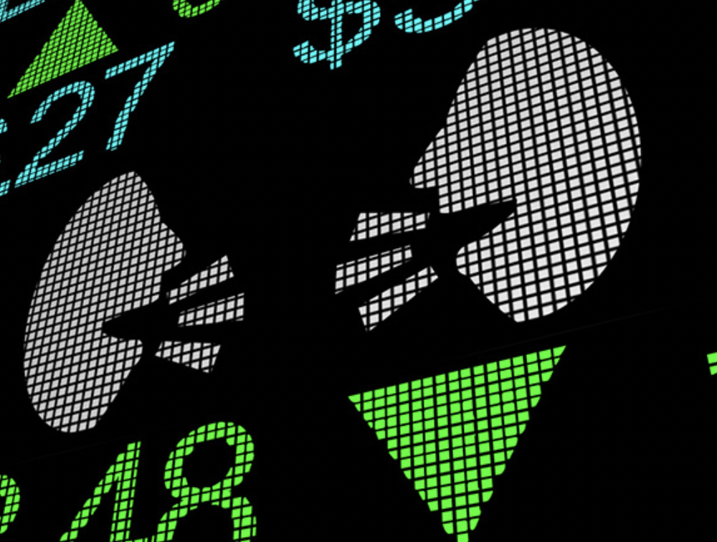

GOAL
From analyzing the average return, shared investment interests or patterns, data pre and post pandemic and trading replicas an attempt is made to explain whether unexpected high profits for congress members come from insider information.
Notes:
The cumulative profits of congress members are benchmarked against stock index S&P 500 as reference to average return.
Secondly, tradings among different congress members are grouped to find possible shared investment interests or patterns.
Thirdly, data pre and post pandemic are compared to investigate the performances during black swan effect.
Lastly, trading will be replicated after disclosure to see whether common investors could follow their investment choices to gain excess profits.

Slide 4
DATASETS
United States financial disclosures website and senatestockwatcher website
Senator trading data
Data size: Jan. 2017 to Jul. 2022
Yahoo finance
S&P 500 data
Notes:
While Congress members are supposed to report the transaction within 30 days, the median delay in reporting that I observed for the trades was 28 days and the average delay was 52 days.

Slide 5
DATA CLEANING METHODOLOGY
Drop NA value
Data Filtering - investment type
Data Parsing - string to number
Download stock price from yahoo finance using yfinance API
Connect each senator investment
with corresponding stock close price
Calculate yearly return of SP500 and
widely chosen stocks
1-LAYER IMAGES

Slide 6
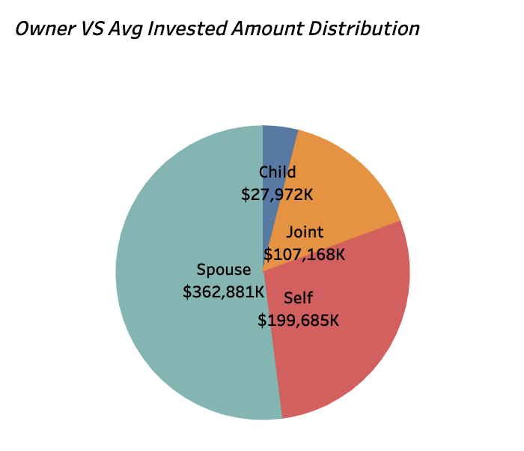
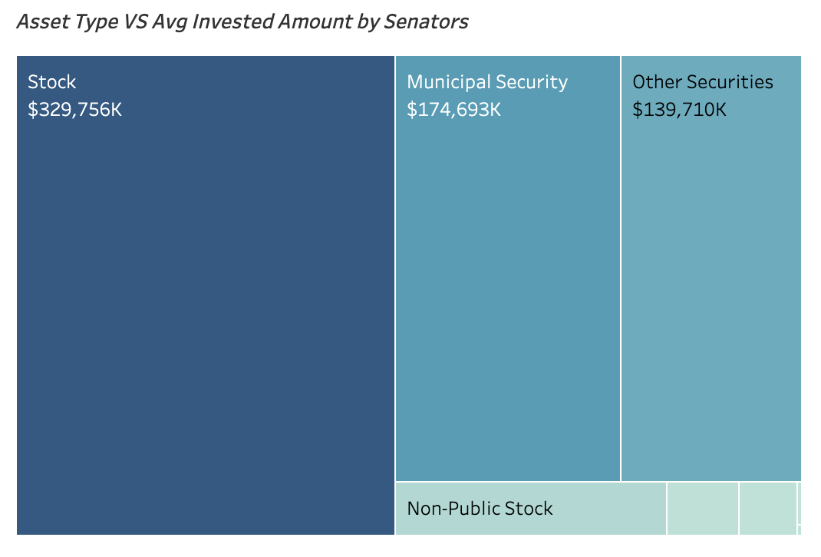
EXPLORATORY DATA ANALYSIS I
Notes:
EXPLAIN THE FULL DATASET COLUMN WISE BY INSERTING THE SCREENSHOT OF THE DATASET IMPORTED IN PYTHON

Slide 7
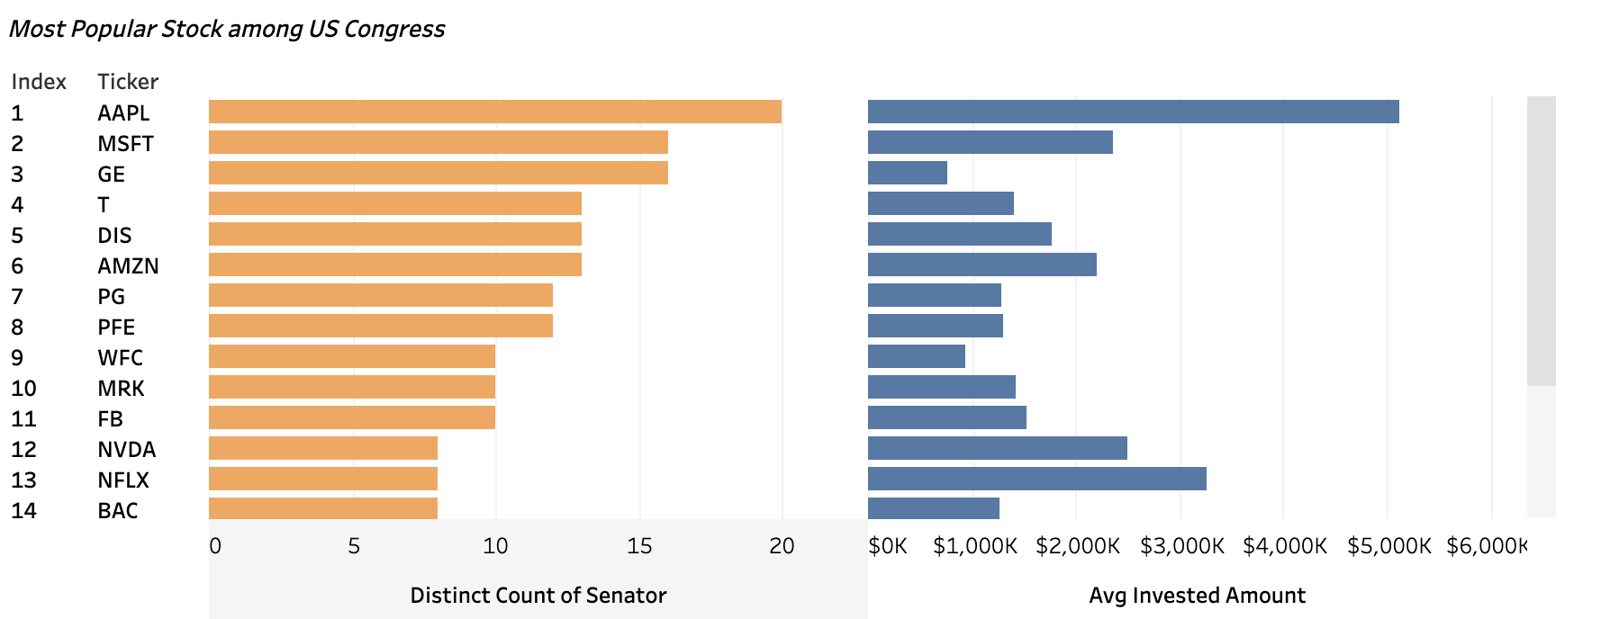
EXPLORATORY DATA ANALYSIS II
500 STOCKS —> TOP 14 STOCKS—> TOP 3 STOCKS
Notes:
ADD DATAFOLIO TO TALK ABOUT EDA

Slide 8
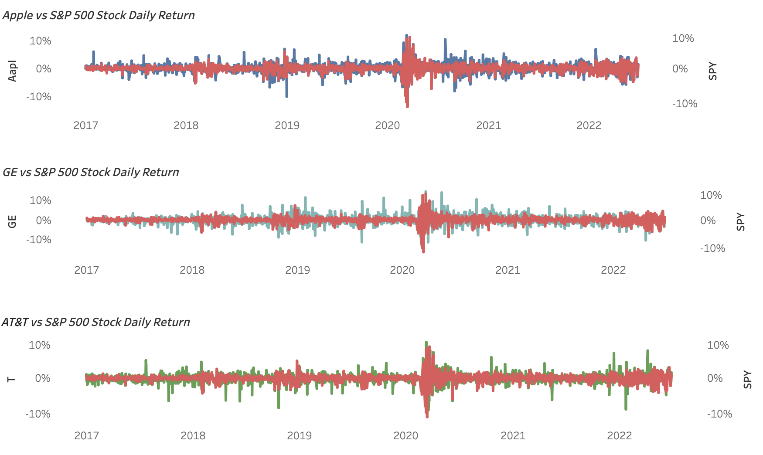
RESULTS
Notes:
PUT HISTOGRAMS, BAR CHARTS ETC TO SHOW VISUALISATION

Slide 9
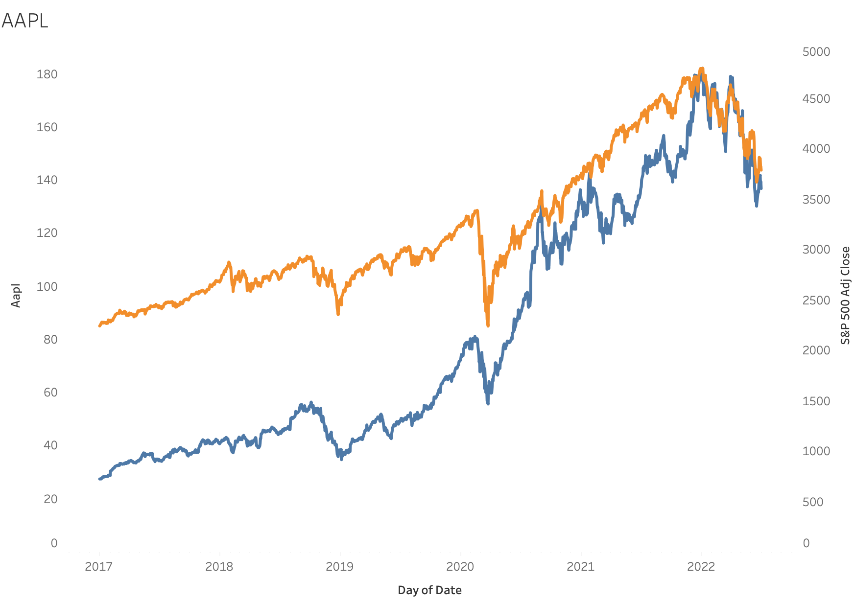
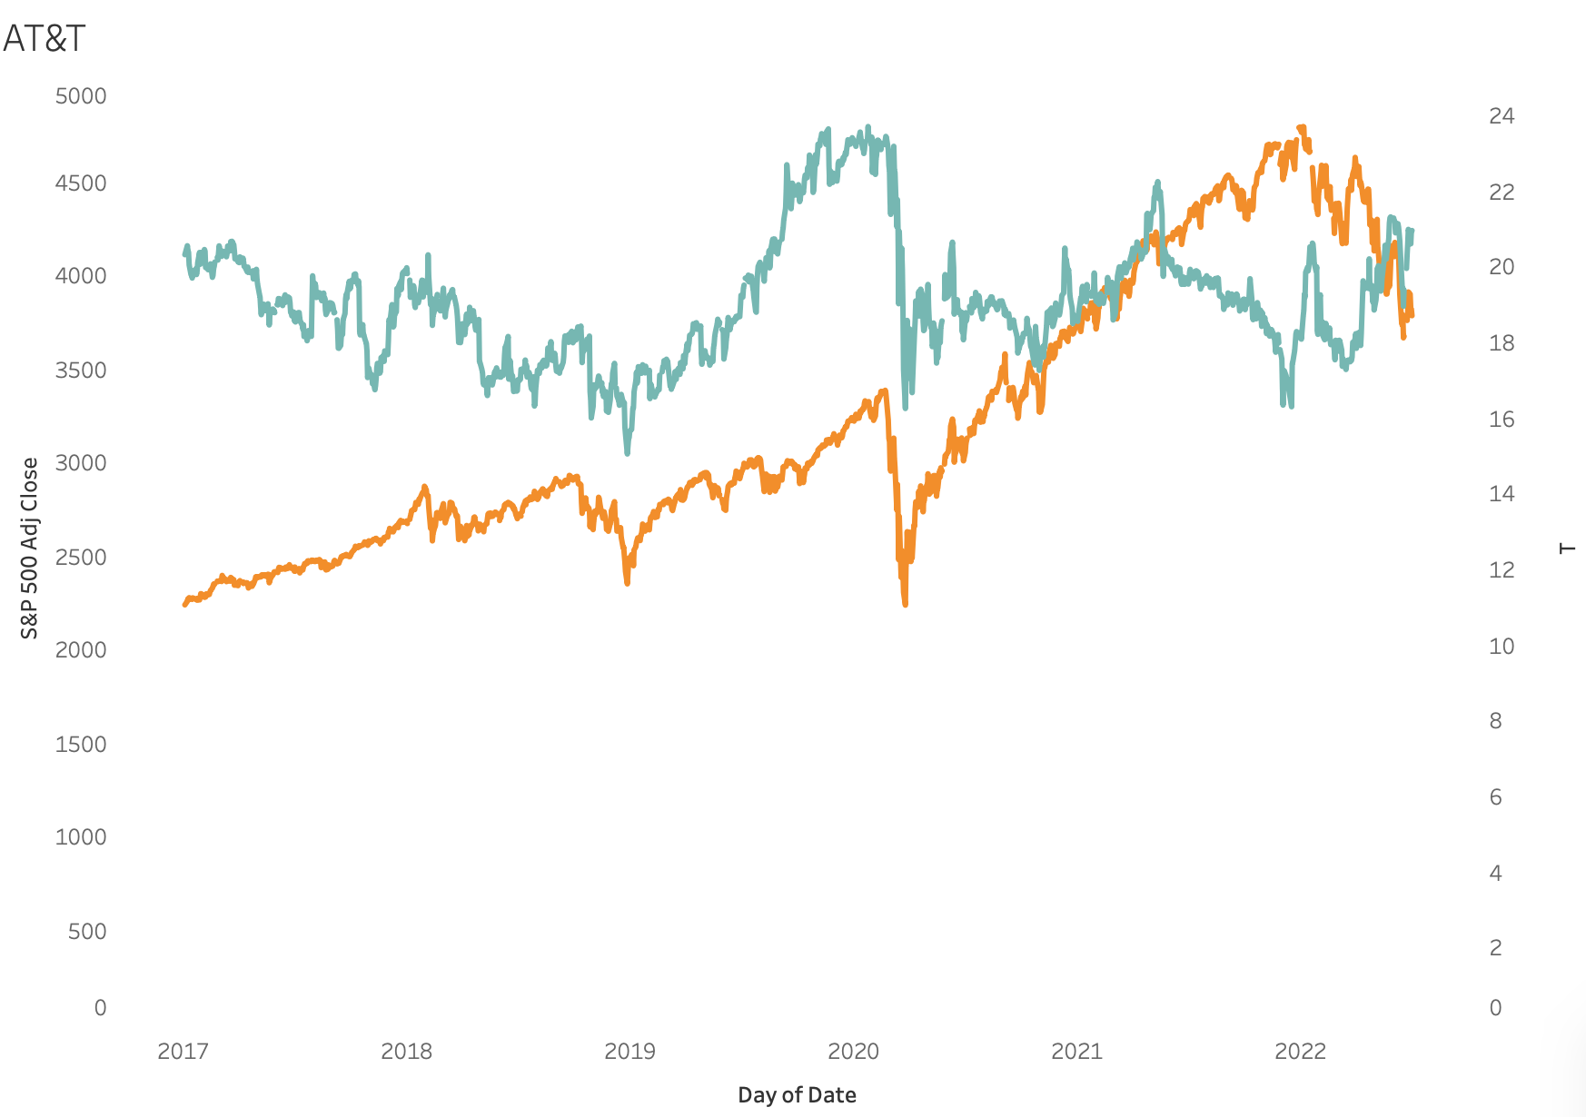
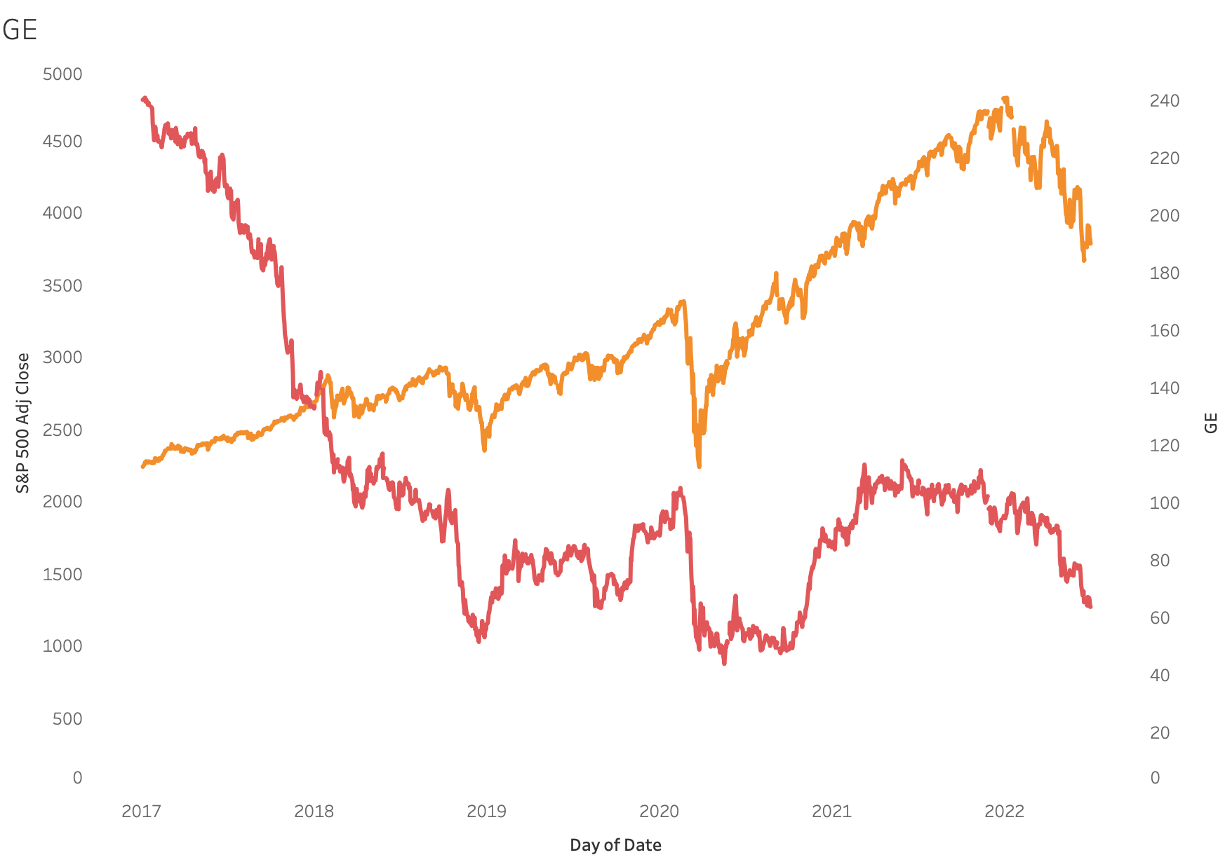
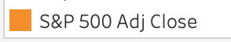

Slide 10
Thank you for watching!

